Slide 1
Question 1: The physical components of a computer system are called __________

Slide 2
Question 2: A __________ is a set of instructions that tells the computer what to do?

Slide 3
Question 3: The brain of the computer is the __________?

Slide 4
Question 4: __________ is the process of finding and fixing errors in software code?

Slide 5
Question 5: Microsoft Word is an example of a(n) __________ software?

Slide 6
Question 6: The __________ is the standard output device of the compute?

Slide 7
Question 7: A collection of related web pages is known as a __________?

Slide 8
Question 8: The shortcut key to undo an action in Microsoft word is _________?

Slide 9
Question 9: __________ memory stores data temporarily and is volatile ?

Slide 10
Question 10: The smallest unit of data in a computer is called a __________?

Slide 11
Question 11: A __________ connects computers within a limited area like a school or office?

Slide 12
Question 12: A __________ is used to connect different networks together?

Slide 13
Question 13: The full meaning of URL is __________?

Slide 14
Question 14: __________ is the process of converting source code into machine code?

Slide 15
Question 15: In programming, a __________ is used to store data values?

Slide 16
Question 16: The keyword used to display output in C language is __________?

Slide 17
Question 17: __________ Software helps protect computers from viruses?

Slide 18
Question 18: The command used to create a directory in Command Prompt is __________?

Slide 19
Question 19: The binary number system is made up of ______and ______?

Slide 20
Question 20: The protocol used to transfer files over the Internet is __________?

Slide 21
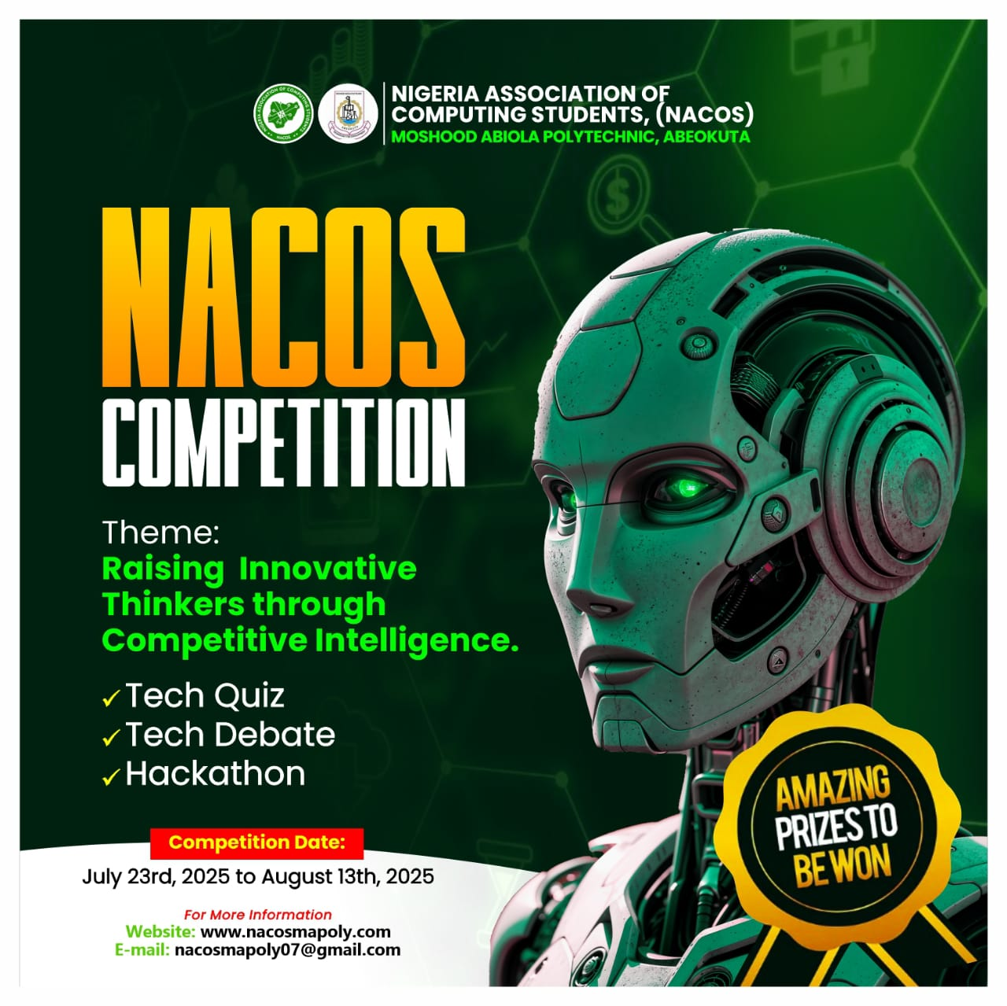
END OF THE SECOND SESSION

